Slide 1
Ai Project
Asawir Hussain
L1S21BSCS0106

Slide 2
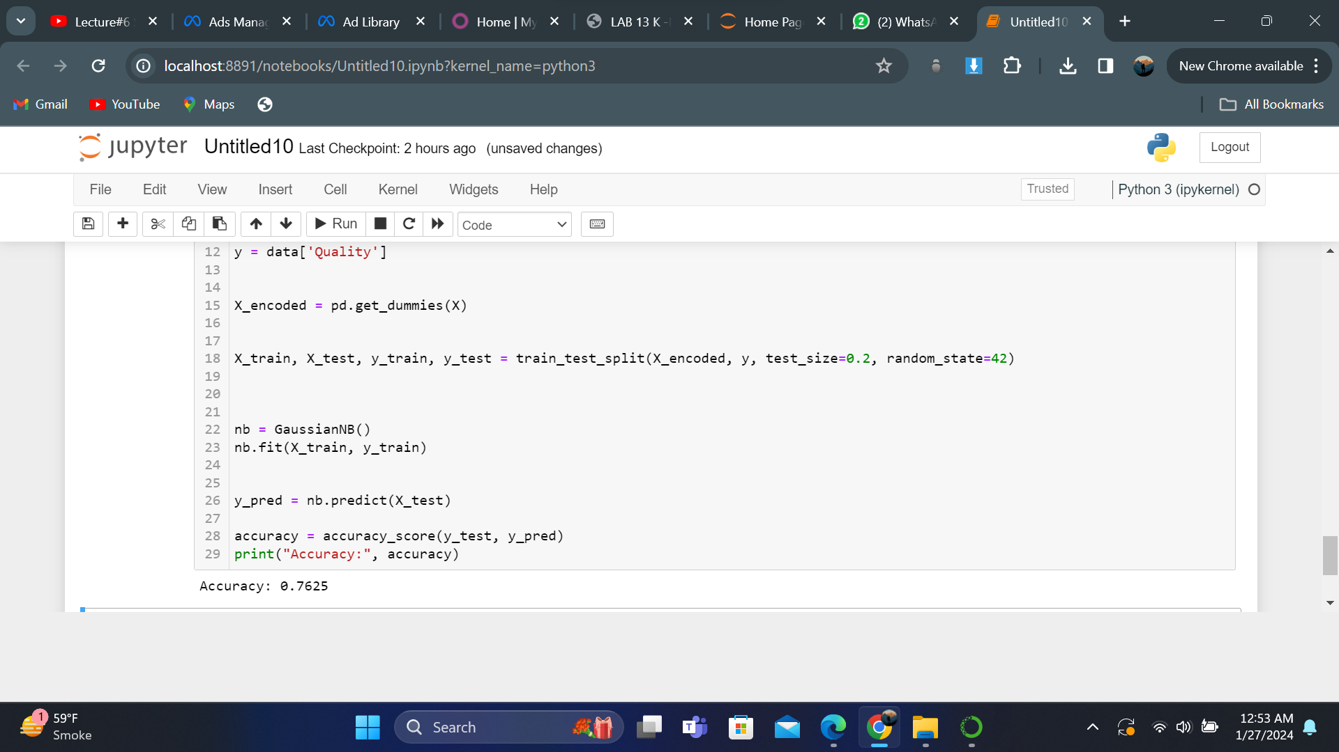
Naïve Byse Classifier’s Output

Slide 3
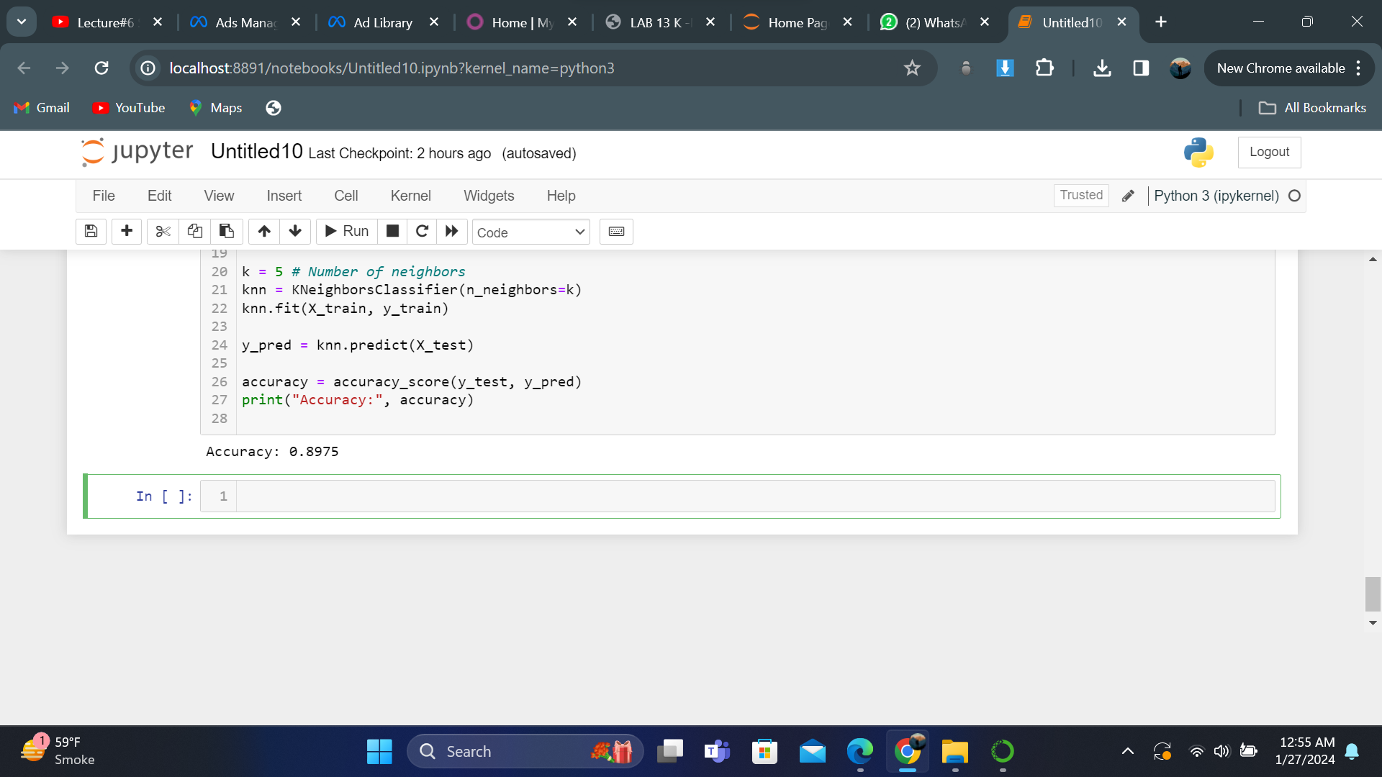
Knn Output

Slide 4
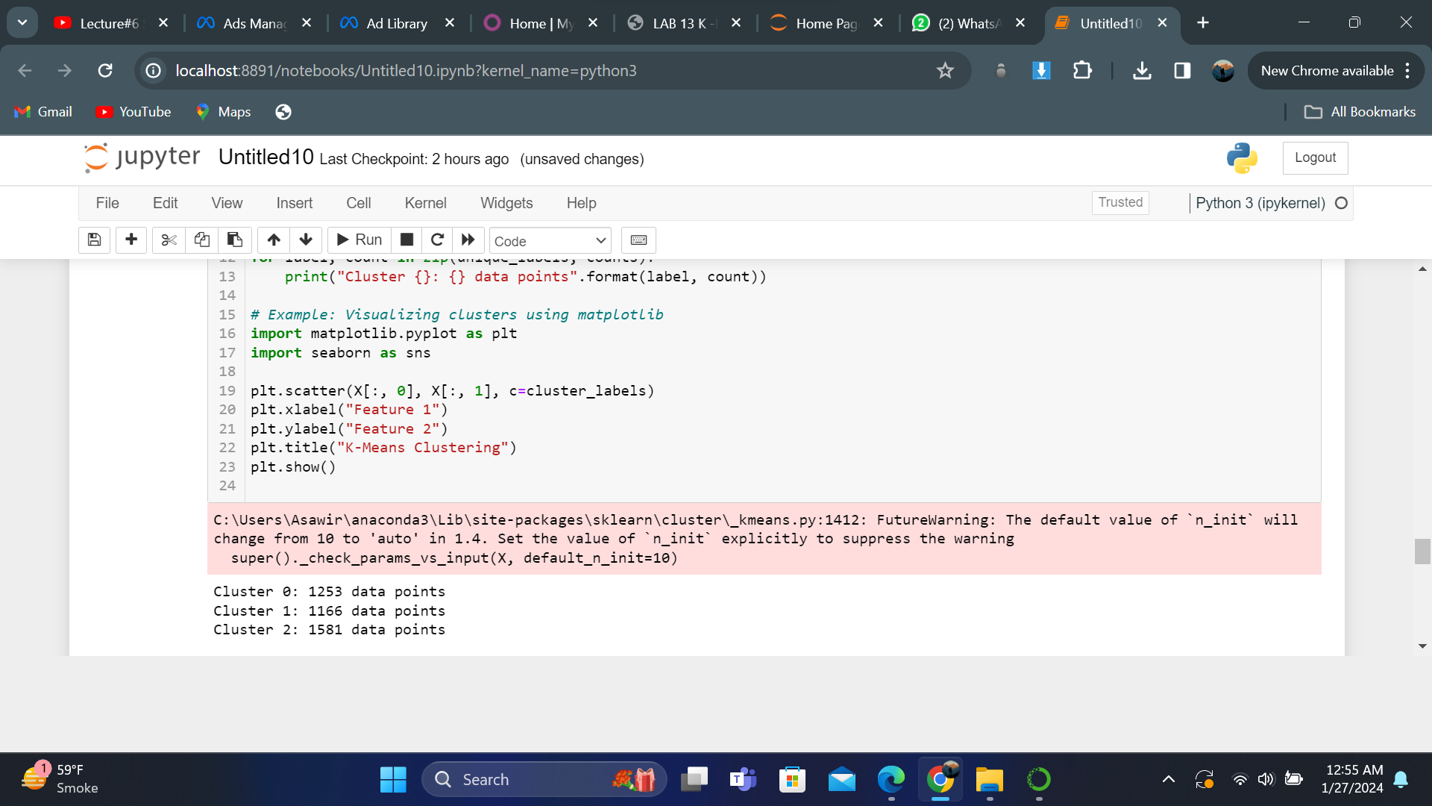
Kmean output

